Slide 1






HEALTHCARE AI ASSISTANT
Team Lead: Mazen Ayman Magdy Hussin
Team Members:
Hasnaa Nageh Ahmed Mohamed
Basma Naser Sadek Mohamed
Ayman Ahmed Ahmed Ali Sanad
Youssef Badr Mohamed ElSayed
Mustafa Yasser Elsaed Ahmad

Slide 2
CONTENTS
01
02
03
04
Introduction &
Problem Overview
Solution & System Architecture
Process Flows
Operational Efficiency

Slide 3


INTRODUCTION & PROBLEM OVERVIEW
01

Slide 4


PROBLEM STATEMENT
Healthcare systems often struggle with:
Manual and slow clinic onboarding
No unified platform for scheduling & appointments
Weak user authentication and lack of 2FA
Patients facing difficulty in finding specialties, clinics, doctors, and available slots
No AI guidance to support patients in their journey

Slide 5
SOLUTION & SYSTEM ARCHITECTURE
02

Slide 6


OUR SOLUTION
A modular backend that provides:
Central Authentication & Security
Controlled Clinic Registration Workflow
Full Clinic Management Panel
Doctor scheduling & auto-generated appointment slots
Smooth Patient browsing and booking
Integrated AI assistant for guidance, recommendations, and appointment support

Slide 7


AUTHENTICATION & SECURITY
Our system provides a complete and secure auth module:
Register + Email Verification
Login with OTP
Two-Factor Authentication (2FA)
Password reset with OTP verification
Refresh token system
Role-based access control for all operations

Slide 8
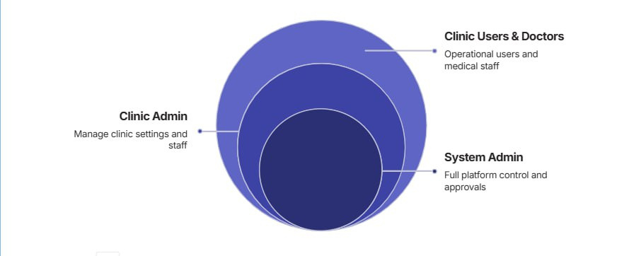
SYSTEM ROLES
System Admin — full system control, approves/rejects clinic requests
Clinic Admin — submits clinic request, manages clinic
after approval
Clinic Users — staff accounts inside each clinic
Doctors — assigned schedules and appointment slots
Patients — view clinics, doctors, schedules, and book
appointments

Slide 9
PROCESS FLOW
03

Slide 10
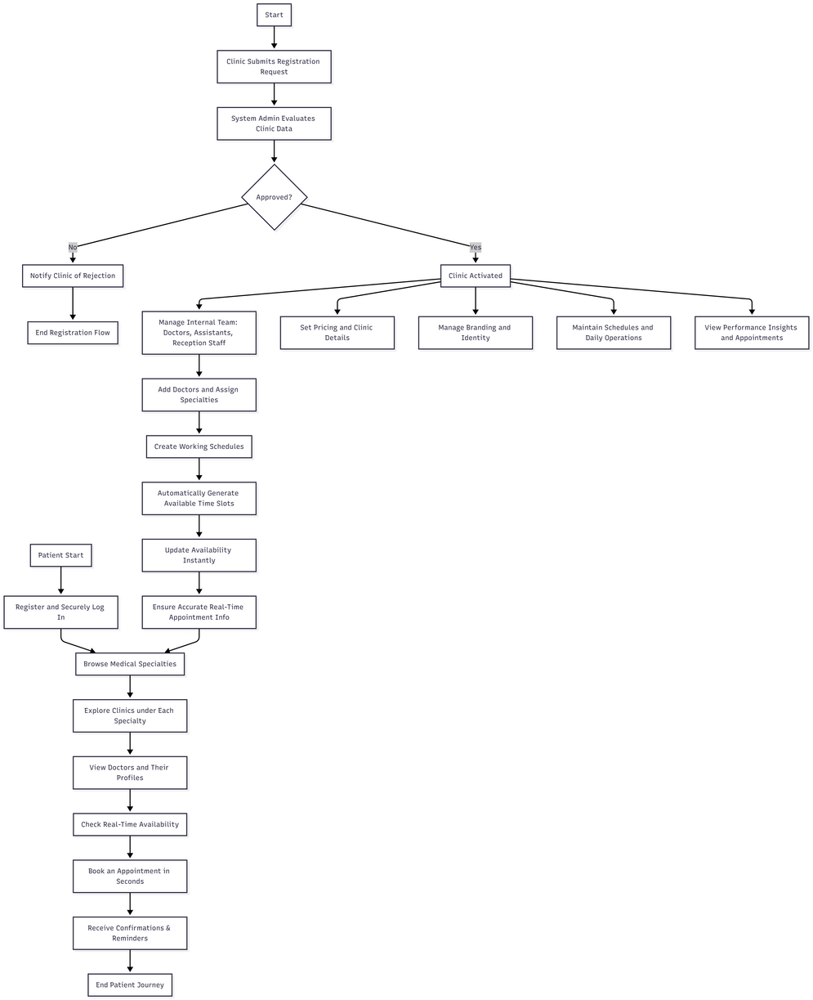
SYSTEM FLOW
A clinic requests to join the platform
The system admin reviews and approves or rejects
An approved clinic becomes active in the ecosystem
Clinic admin adds doctors and staff
Doctors’ schedules and available time slots are created
Patients register and access the system
Patients browse specialties → clinics → doctors
They view available times and book appointments
AI Assistant guides patients and enhances the service experience

Slide 11
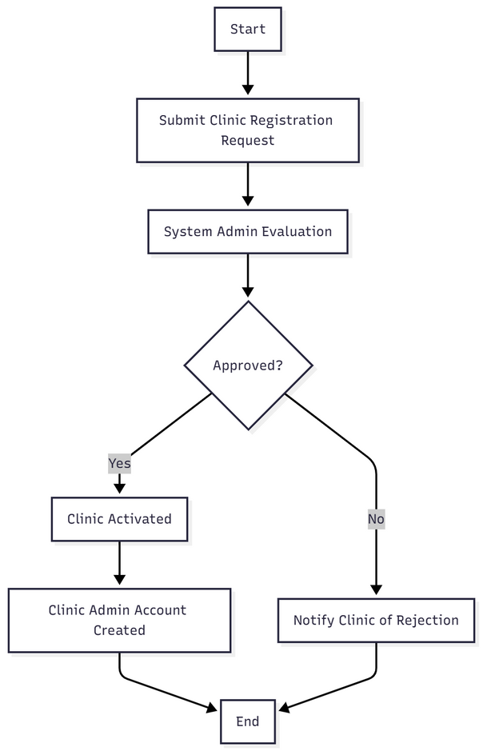
CLINIC REGISTRATION FLOW
Clinics start by submitting a digital registration request
The system admin evaluates the clinic’s data
Once approved:
The clinic becomes part of the platform
A clinic administrator account is created
This ensures quality, legitimacy, and controlled access to the healthcare network.

Slide 12
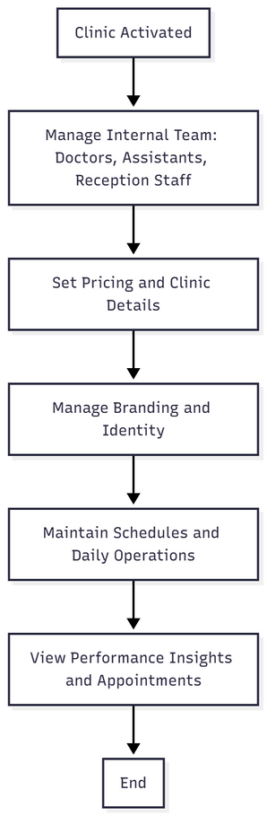
CLINIC MANAGEMENT CAPABILITIES
Once activated, each clinic can:
Manage its internal team (doctors, assistants, reception staff)
Set pricing and clinic details
Manage its branding (like clinic logo and identity)
Maintain schedules and daily operations
View performance insights (appointments, demand patterns)

Slide 13
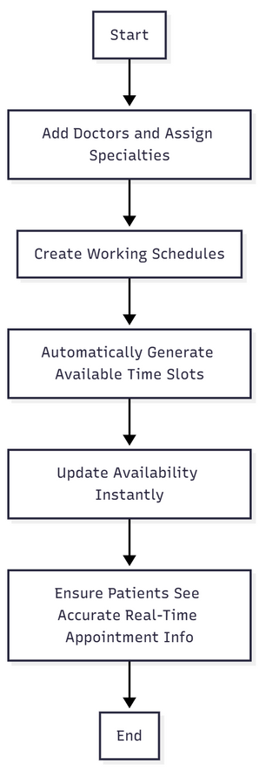
DOCTOR & SCHEDULE MANAGEMENT
Clinics can:
Add doctors and assign medical specialties
Create their working schedules
Automatically generate available time slots
Update availability instantly
This ensures patients always see accurate, real-time appointment information.

Slide 14
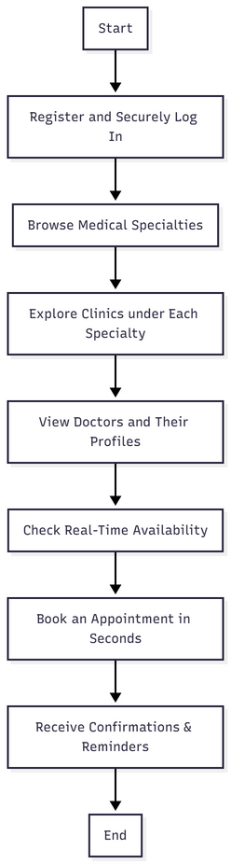
PATIENT JOURNEY
Patients can:
Register and securely log in
Browse medical specialties
Explore clinics under each specialty
View doctors and their profiles
Check real-time availability
Book an appointment in seconds
Receive confirmations & reminders

Slide 15
OPERATIONAL EFFICIENCY
04

Slide 16

OPERATIONAL EFFICIENCY
Significantly reduces paperwork by digitizing all operational processes.
Minimizes human errors through automated workflows and standardized procedures.
Saves valuable time for both medical staff and patients, resulting in faster service delivery.
Provides real-time visibility into clinic performance, enabling more effective monitoring and control.

Slide 17
FUTURE ENHANCEMENTS
AI-Powered Appointment Booking (Chat-Based)
AI Triage & Medical Guidance
Voice Assistant Integration
Smart Doctor Recommendation Engine
EMR Integration
Intelligent Notifications & Reminders
Real-Time Chat with Clinic Staff
Dynamic Pricing Optimization (AI-Based)

Slide 18
CONCLUSION
Our platform represents a major step toward modern, efficient, and transparent healthcare services.
It empowers clinics, enhances patient experiences, and supports decision-makers with reliable insights — paving the way for a smarter healthcare ecosystem across the region.

Slide 19
THANK YOU
AND STAY HEALTHY

